Slide 1

SMART INDIA HACKATHON 2026
TITLE PAGE
Problem Statement ID – SIH26184
Problem Statement Title – Development of a Predictive Analytics Framework for Cybercrime Complaints to Forecast Likely Cash Withdrawal Locations in Advance, Enabling Generation of Actionable Intelligence for Timely and Proactive Cybercrime Intervention.
Theme – Blockchain & Cybersecurity
PS Category – Software
Team ID – UNFAZED
Team Name – UNFAZED

Slide 2
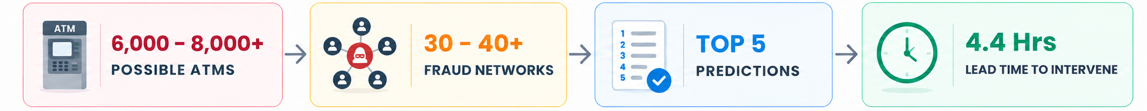
IDEA TITLE - Predictive Fund-Flow Analysis for Cybercrime Investigations
UNFAZED
Proposed Solution:
THE PROBLEM
OUR SOLUTION
NOVELTIES
Investigations start too late.
Fund moves across fraud networks & multiple accounts.
Too many possible cash-out locations causes slow investigation.
Lack of explainable predictions makes it hard to decide location.
Predicts cash-out with 4.4 hours lead time (vs baseline model)
Identifies Fraud Networks by linking complaints & transactions.
Shortlists the Top 5 locations from all possible withdrawal points.
Shows the explainable reasons, along with its confidence score.
Point-in-Time Graph Intelligence
  Rebuilds the entire graph when complaint is filed, preventing data-leakage flaw that inflates accuracy.
Cross-Complaint Network Discovery
  Identifies fraud networks, related accounts and other victims cases.
Predictive Cash-Out Ranking
  Narrows cash-out points to a list of 5. Nearly 4x better than a standard tabular fraud model.
Explainable & Calibrated Predictions
  Confidence scores are backed by the factors that influenced each prediction.
OUR SOLUTION

Slide 3
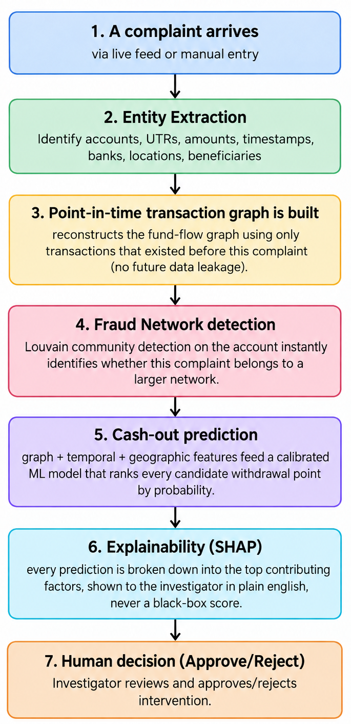
TECHNICAL APPROACH
UNFAZED
WORKFLOW
TECHNOLOGIES USED
BACKEND:
  Python - Language for the API, ML pipeline, and graph engine
  FastAPI - REST API framework
  Uvicorn - Server
  SQLite (demo) - Database, designed to be Postgres for production
  Pydantic - Request/response validation
MACHINE LEARNING:
  XGBoost - Gradient-boosted ranking model
  scikit-learn - Calibration, baseline model, evaluation metrics
  SHAP - Model explainability
  pandas / NumPy - Data processing and feature engineering
  NetworkX - Transaction graph, Louvain community detection (fraud ring discovery)
FRONTEND:
  React 18 · Vite · Recharts · Leaflet (Maps)· react-force-graph-2d (Network Vizualization)

Slide 4
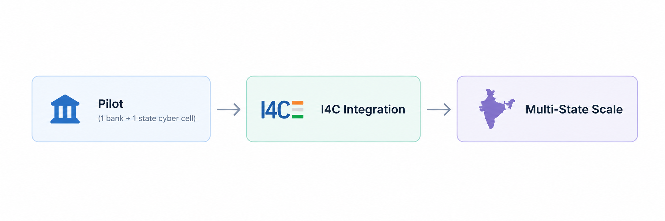
FEASIBILITY AND VIABILITY
UNFAZED
FEASIBILITY
CHALLENGES
Working end-to-end prototype: Complaint → Graph → Prediction → Explanation.
Validated at realistic scale: 700+ complaints, 1,500+ mule accounts, 2,400+ transfers, 5 cities.
Lightweight compute requirements: Runs on normal infrastructure. No GPU clusters required.
High-quality synthetic dataset: Realistic fraud networks, multi-hop flows and geographic patterns.
Production-ready architecture: SQLite (demo) → PostgreSQL (production)
Designed for real-world adoption: Can be Integrated with existing NCRP Workflows.
Data Silos: Live data from banks & states requires MoUs & API integration.
False positives: Large no. of locations = even strong model can produce incorrect results.
Evolving Patterns: Fraud networks change patterns & behaviours overtime.
Privacy: Sensitive data requires DPDP Act-grade data protection.
STRATEGIES FOR OVERCOMING CHALLENGES
Phase Launch: One bank + state cyber cell → Scale to multiple.
Human Approval: Requires Human approval before any action.
Continuous retraining: Retraining using newly closed cases to adapt to evolving behaviour.
Privacy: Display obfuscated codes instead of raw sensitive data.
DEPLOYMENT ROADMAP

Slide 5
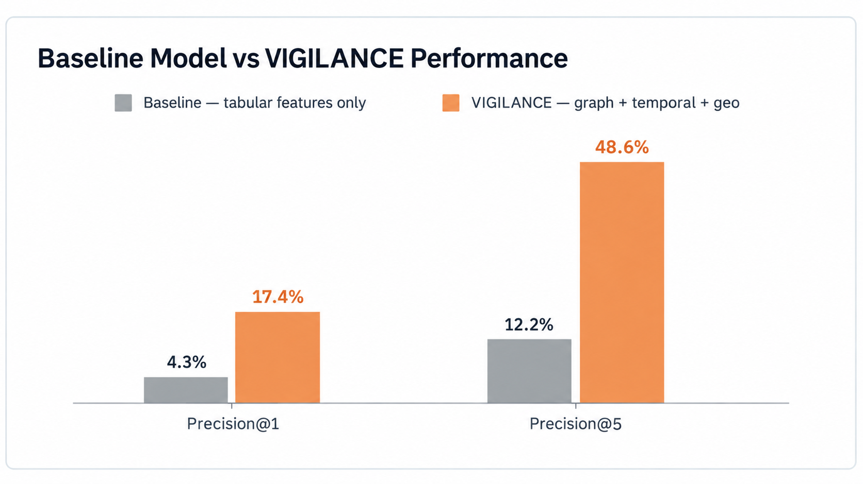
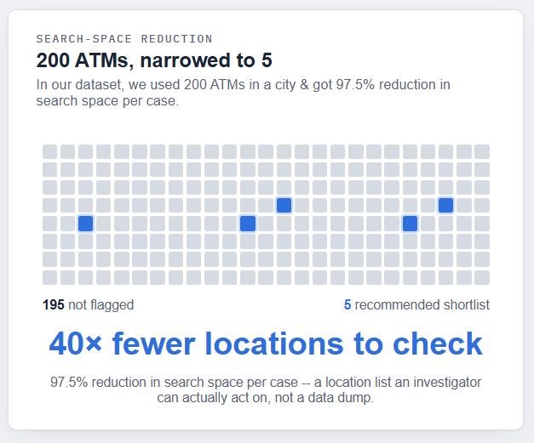
IMPACT AND BENEFITS
UNFAZED
IMPACTS ON CYBERCELLS
SOCIAL & ECONOMICAL BENEFITS
Faster investigations: Reduces hundreds of possible withdrawal endpoints to a ranked Top-5 shortlist
Earlier intervention: In our modeled dataset, 121 of 138 test cases had a real filing-to-cash-out window, averaging 4.4 hours.
Fraud Network visibility: One complaint can uncover 30-40+ linked mule accounts and other victim cases, expanding investigative reach.
Measurable Performance: Prototype evaluation shows 48.6% Precision@5 vs 12.3% Baseline, with an average 4.4-hour lead on actionable cases.
Higher recovery potential: Earlier intervention can improve chances of actual victim recovery.
Public trust: Strengthens confidence in India's growing digital-payment ecosystem.
Lower investigation cost: Reduces manual tracing effort and helps cyber cells handle more cases.
National-scale impact: India loses thousands of crores annually. Small lift in recovery is crores at national volume.

Slide 6
RESEARCH AND REFERENCES
Your Team Name
Details / Links of the reference and research work

Slide 7
IMPORTANT INSTRUCTIONS
Please ensure below pointers are met while submitting the Idea PPT:
Kindly keep the maximum slides limit up to six (6). ( Including the title slide)
Try to avoid paragraphs and post your idea in points /diagrams / Infographics /pictures
Keep your explanation precise and easy to understand
Idea should be unique and novel.
You can only use provided template for making the PPT without changing the idea details pointers (mentioned in previous slides).
You need to save the file in PDF and upload the same on portal. No PPT, Word Doc or any other format will be supported.
Note - You can delete this slide (Important Pointers) when you upload the details of your idea on SIH portal.

